Slide 1

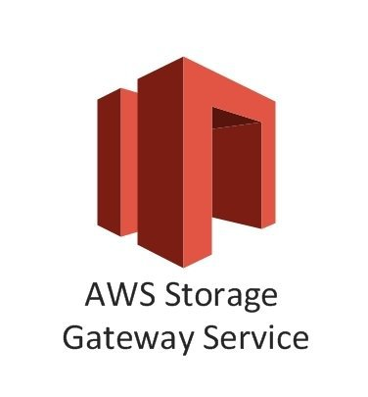

Slide 2


What is Storage Gateway
Aws Storage Gateway is a hybrid cloud storage service that connects an on-premises software application access to virtually unlimited cloud storage.
It provides low-latency performance by caching frequently accessed data on premises, while storing data securely and durably in Amazon cloud storage services.
The service enables you to securely store data to the AWS cloud for scalable and cost-effective storage.

Slide 3

Storage Gateway
Your Data Center
AWS

Slide 4
Storage Gateway
AWS Storage Gateway's software application is available for download as a virtual machine (VM) image that you install on a host in your datacenter.
Storage Gateway support either VMware ESXi or Microsoft Hyper-V.
Once you've installed your gateway and associated it with your AWS account through the activation process, you can use the AWS Management console to create the storage gateway option that is right for you

Slide 5



Type of Storage Gateway
File Gateway(NFS & SMB)
Volume Gateway(iSCSI)
Stored Volume
Cached Volume
Tape Gateway(VTL)

Slide 6
File Gateway
Files are stored as objects in your S3 buckets, accessed through a Network file system(NFS) mount point. Ownership, permissions and timestamps are durably stored in S3 in the user meta-data of the object associated with the file.
Once objects are transferred to S3, they can be managed as native S3 objects and bucket policies such as versioning, lifecycle management and cross-region replication apply directly to objects stored in your bucket.

Slide 7
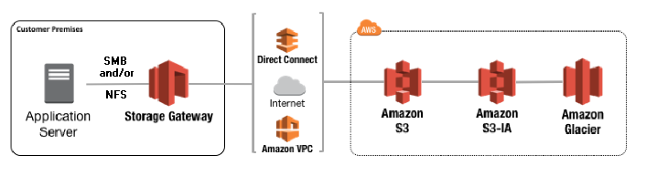

Slide 8
Volume Gateway
The Volume interface presents your applications with disk volumes using the iSCSI block protocol.
Data written to these Volume can be asynchronously backed up as point-in-time snapshots of your volumes and stored in cloud as AWS EBS snapshots.
Snapshots are incremental backups that capture only changed blocks. All snapshot storage is also compressed to minimize your storage charges.
Example : storing virtual disk into cloud

Slide 9

Volume Gateway – Stored Volumes
Stored volumes let you store your primary data locally, while asynchronously backing up that data to AWS. Stored volumes provide your on-premises applications with low-latency access to their entire datasets, while providing durable, off-site backups.
You can create storage volumes and mount them as iSCSI (Internet Small Computer Systems Interface) devices from your on-premises application servers. Data written to your stored volumes is stored on your on-premises storage hardware.
This data is asynchronously backed up to Amazon S3 in the form of AWS EBS snapshot. 1GB - 16TB in size of Stored Volumes.

Slide 10
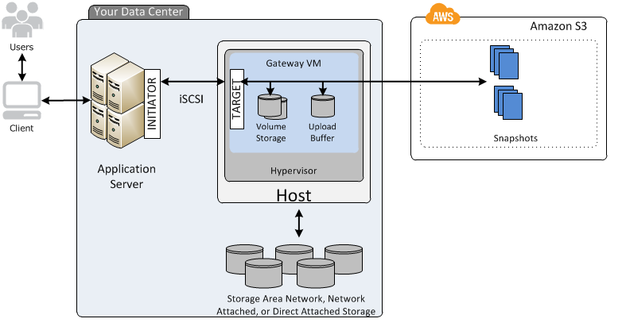
Volume Gateway – Stored Volumes

Slide 11

Volume Gateway – Cached Volumes
Cached volumes let you use Amazon S3 as your primary data storage while retaining frequently accessed data locally in your storage gateway.
Cached Volumes minimize the need to scale your on-premises storage infrastructure, while still providing your applications with low-latency access to their frequently accessed data.
You can create storage volumes up to 32 TiB in size and attach to them as iSCSI devices from your on-premises application servers.
Your gateway stores data that you write to these volume in AWS S3 and retains recently read data in your on-premises storage gateway's cache and upload buffer storage. 1GB-32Tb in size for Cached Volumes.

Slide 12
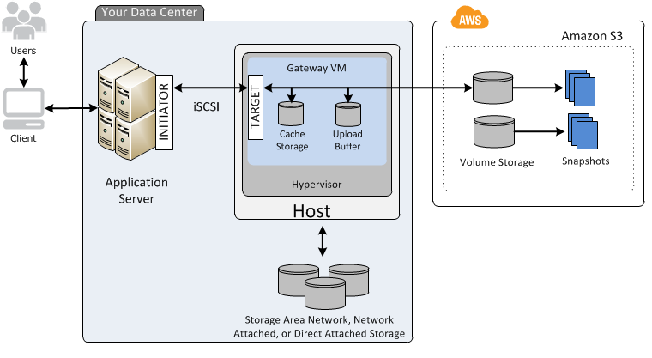
Volume Gateway – Cached Volumes

Slide 13
Taped Gateway
Tape Gateway offers a durable, cost-effective solution to archive your data in the AWS Cloud. The VTL interface it provides lets you leverage your existing tape-based backup application infrastructure to store data on virtual tape cartridges that you create on your tape gateway.
Each tape gateway is preconfigured with a media changer and tape drives, which are available to your existing client backup applications as iSCSI devices. You add tape cartidages as you need to archive your data. Supported by NetBackup, Backup Exec, Veeam etc.

Slide 14
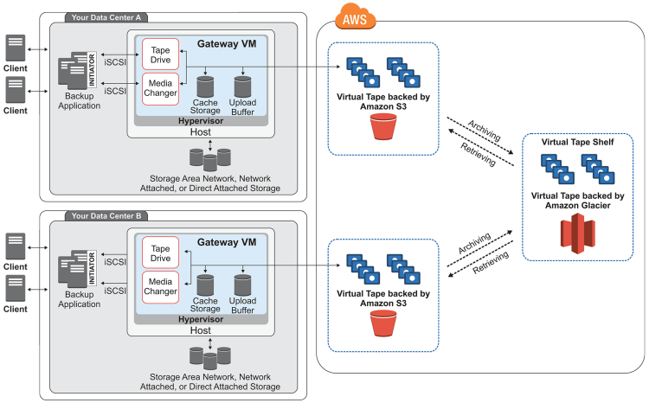
Volume Gateway – Taped Volumes

Slide 15

Exam Tips
File Gateway:
File Gateway - For Flat files Stored directly on S3
Volumes Gateway :
Stored Volumes - Entire Dataset is stored on site and is asynchronously backed up to S3
Cached Volumes - Entire Dataset is stored on S3 and most frequently accessed data is cached on site
Virtual Tape Library

Slide 16
Thank you

